Slide 1
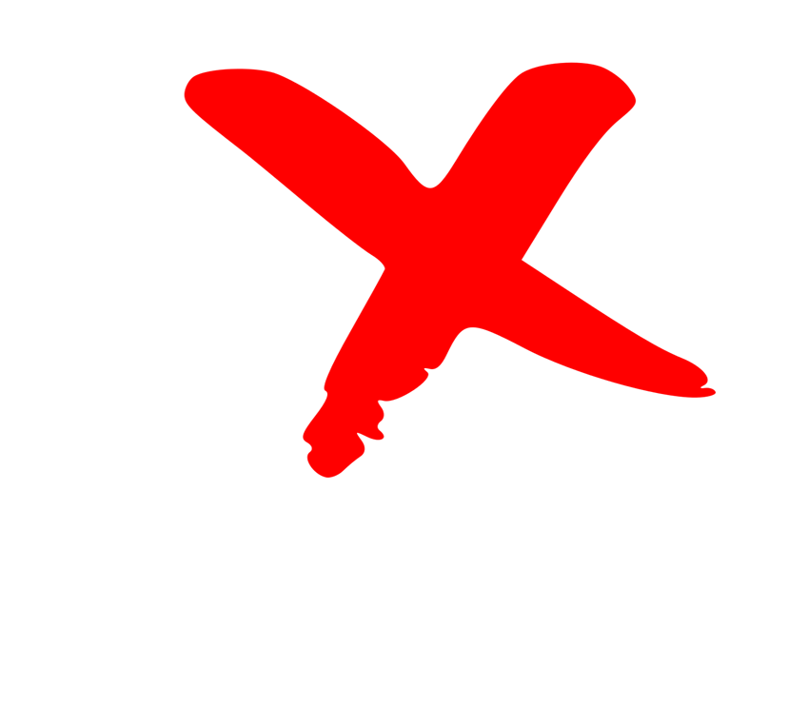
Build awareness of our impact and brand
How can you start? Show people outside Rotary that we are people of action.
The beginning is understanding our brand and how we use different elements of our brand correctly and consistently.
How many branding mistakes can you spot?
Always use your club or the district identifier (correct logo) (a)
In naming events, fundraisers use your full club name (b)
The yearly theme is going away – it was intended only for internal communications (c)
Don’t use the legacy “old” Rotary Wheel for any purpose* (d)
Don’t change the opacity, watermark, cut off any part of the Mark of Excellence or put text or images over the Mark of Excellence or Masterbrand Signature (e)
Lockups are only used to partner, event, program, or sponsor’s logo or name to show your club’s affiliation with the
(a)
(b)
(e)
(c)
(e)
(e)
(d)
(f)
* The “new” club logo was introduced in 2013
September 28, 2024 | District Leadership Meeting

Slide 2
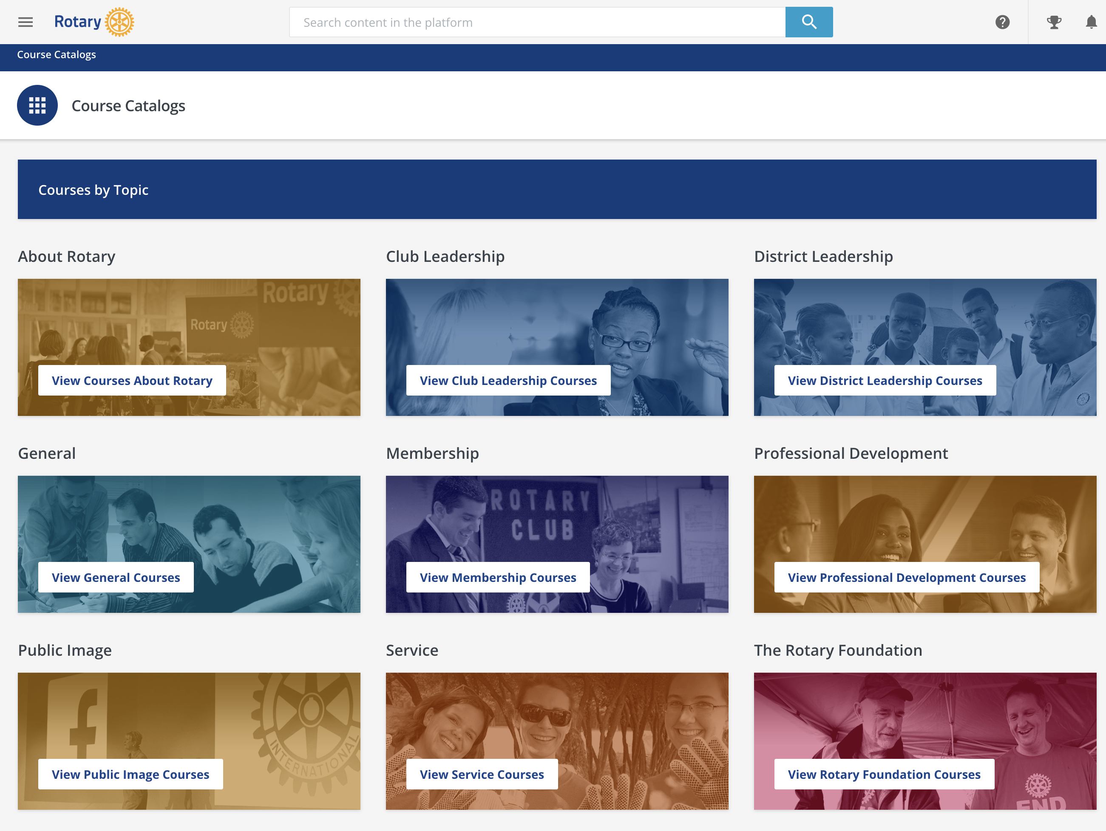
What you can do today
Use the Brand Center to create your club logo and the resources to ensure you always use the correct branding
Take the Learning Center Public Image Courses
Review your website and social media accounts and update the branding wherever it’s needed
Appoint a Public Image chair to be included in district Brand updates
Learning Center
Tip: Take the “Our Logo: Representing Rotary” course to learn more about club logos
Make sure that you and your club members are representing our brand in the hats and shirts you wear, signage and the materials you hand out to make sure they adhere to Rotary’s brand guidelines.
Incorrect usage
September 28, 2024 | District Leadership Meeting

